Slide 1
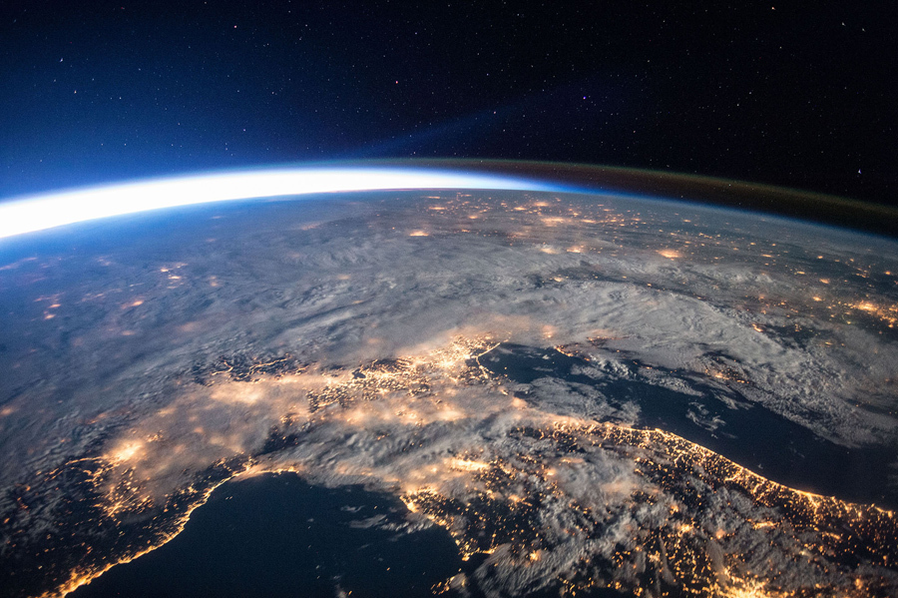
The Space Environment Plasma Part 1
The plasma environment
Plasma oscillations
Adapted from information in:
The Space Environment (TSE), by Tribble
Space Mission Analysis and Design (SMAD), Edited by Wertz and Larson
Notes:
5 key areas
Before moving into the details of designing space missions, it’s important to take a look at the constraints we’ll be operating under
Expedition 47 from the ISS

Slide 2
Summary of environmental effects

Slide 3
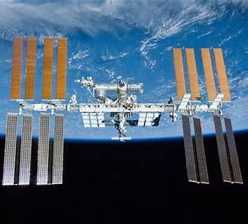

Jacob Lerner
Homework problem 1a
Write:
Summarize the presentation
2) Describe something you learned from it
3) Write one question you have left about the presentation

Slide 4
Dervens Marsielle
Homework Problem 1b
Write:
Summarize the presentation
2) Describe something you learned from it
3) Write one question you have left about the presentation

Slide 5
Miranda Robinson
Homework Problem 1c
Write:
Summarize the presentation
2) Describe something you learned from it
3) Write one question you have left about the presentation

Slide 6
Impact of the Space Environment on Spacecraft Systems
Space Environments
Vacuum | Neutral | Plasma | Radiation | MM/OD
Spacecraft Subsystems | Solar UV | Outgassing/ Contamination | Aerodynamic Drag | Sputtering | Atomic Oxygen | Spacecraft Glow | Spacecraft Charging | Van Allen Belts | Galactic Cosmic Rays | Solar Proton Events | Impacts
Attitude Determination & Control |  | Degradation of sensors | Induced torques |  |  | Interference with sensors | Torques due to induced potentials
Avionics |  |  |  |  |  |  | Upsets due to EMI from arcing |  |  |  | EMI due to impacts
Electrical Power |  |  |  |  |  |  | Shift in floating potential, reattraction of contaminants |  |  |  | Destruction/ obscuration of solar cells
Propulsion |  | Thruster plumes may be a contaminant source | Drag makeup fuel requirement |  |  |  | Shift in floating potential due to thruster firings |  |  |  | Rupture of pressurized tanks
Structures |  |  |  |  |  |  |  |  |  |  | Penetration
Telemetry, Tracking & Communications |  | Degradation of sensors |  |  |  | Interference with sensors | EMI due to arcing |  |  |  | EMI due to impacts
Thermal Control |  |  |  |  |  |  | Reattraction of comtaminants |  |  |  | Degradation of alpha/epsilon
Change in sensor coatings
Degradation: SEUs, bit errors, …
Change in coverslide transmittance
Change in coverslide transmittance
Degradation of solar cell output
Change in sensor coatings
Degradation of electronics
Change in surface alpha/epsilon ratio
Change in surface alpha/epsilon ratio
Cold surfaces may experience heating
TSE, Fig 7.1
Notes:
A variety of environmental effects have a direct impact on the ability of spacecraft subsystems to execute their design objectives
This chart provides a good summary of the impacts of the space environment on these subsystems
⇒ we’ll walk through each of these areas in the next several slides
Must recognize that extra margin must be designed into spacecraft subsystems to handle these impacts

Slide 7


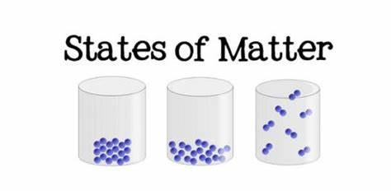
WHAT ARE THE states of matter?

Slide 8
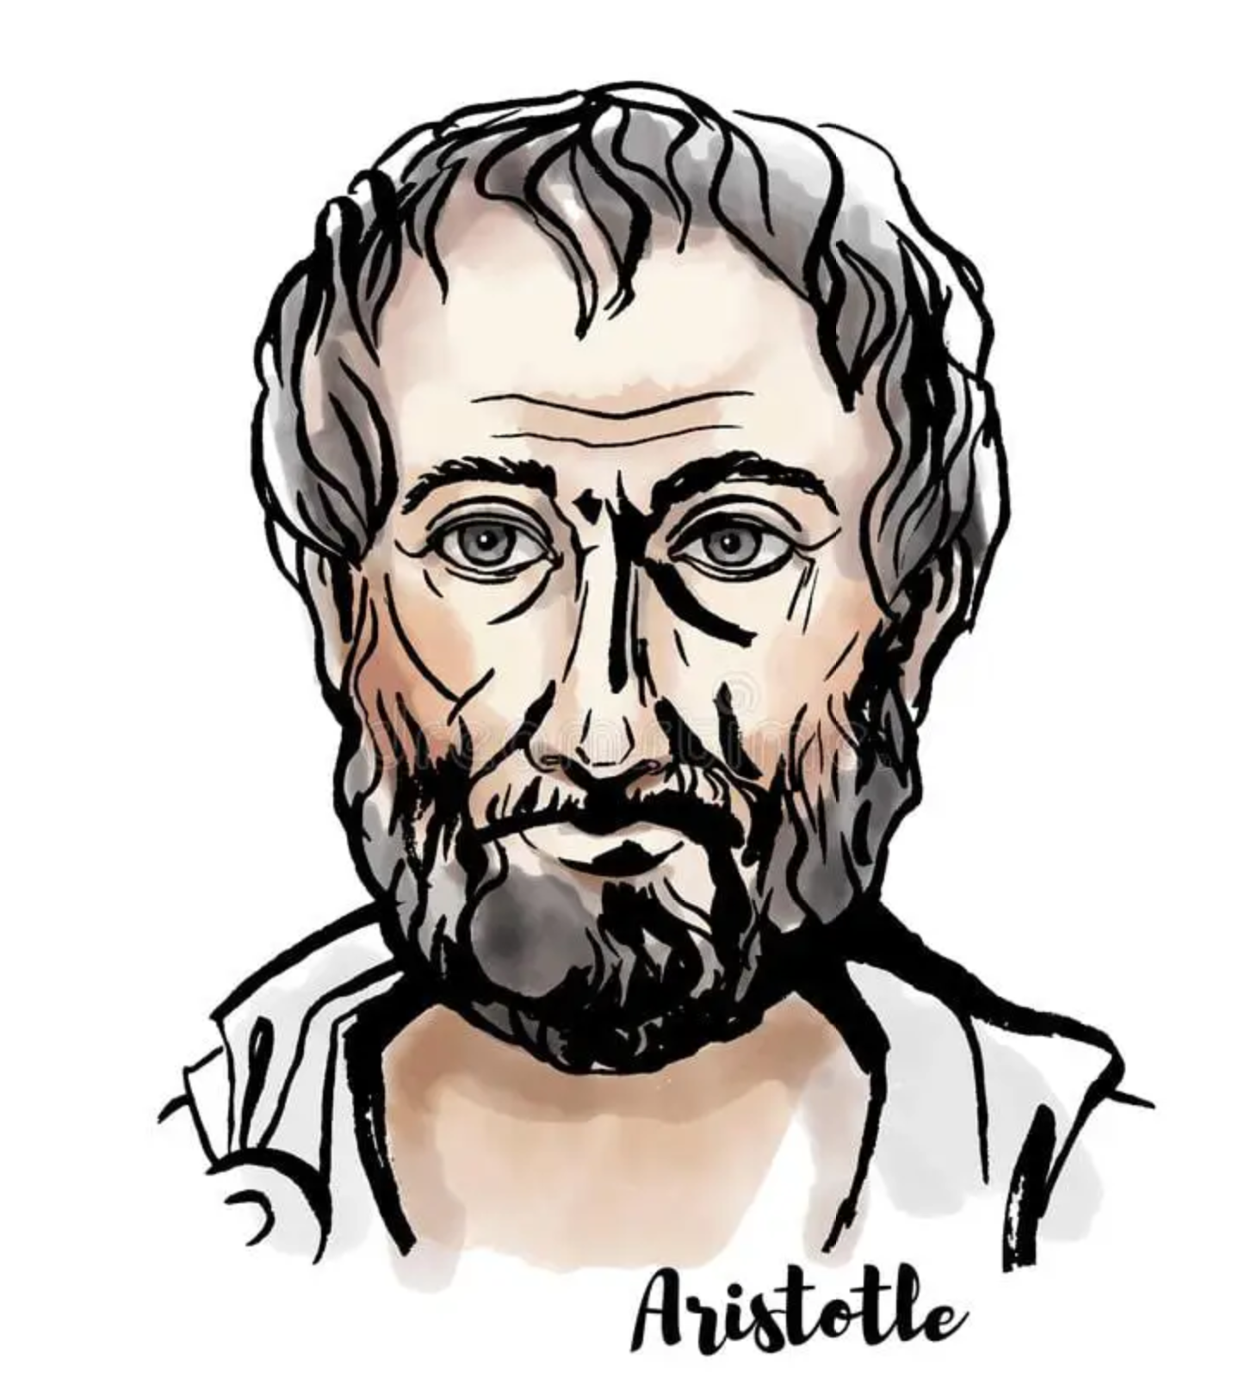
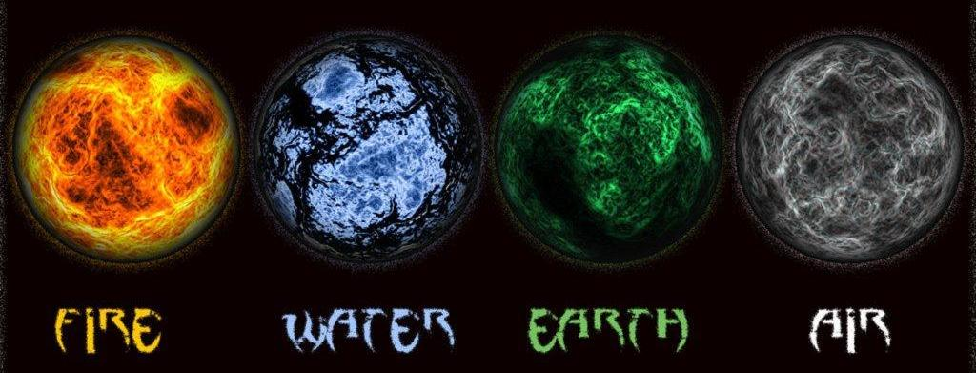
4 states of matter?

Slide 9

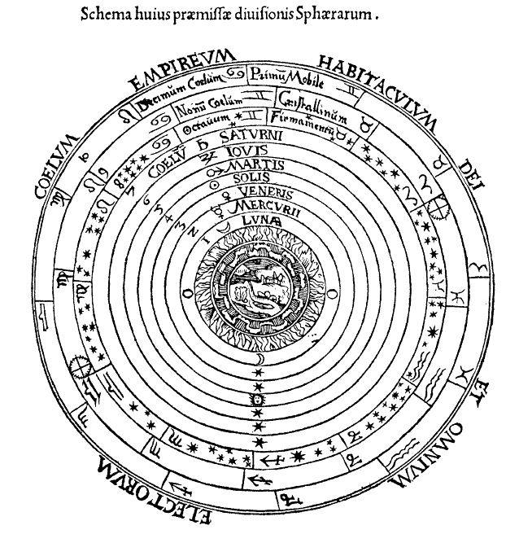
Aristotle’s view of the universe

Slide 10
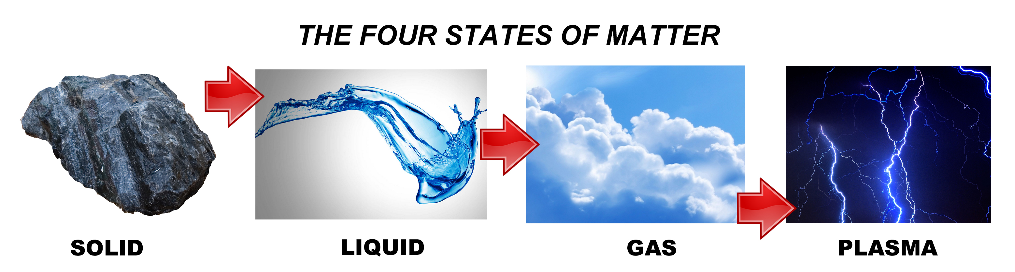
NATURAL STATES OF MATTER

Slide 11
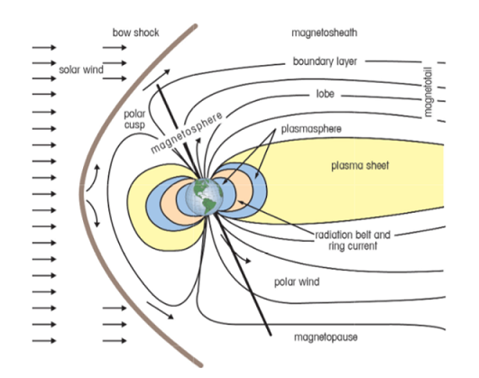
The Plasma Environment and Potential Effects
Impede communications
Affect measurements
Distort satellite navigation data
Differential charging and electrostatic discharges
Eroding and contamination
Wake can affect instrument and subsystem performance
Power loss from solar arrays
Notes:
“gas” of electrically charged particles with kinetic energy greater than the potential energy of attraction
(absolute value is rarely of concern)
Closely spaced surfaces create equilibrium by forming a current path
EMI is a problem for sensitive electronics
Effects are similar to the neutral environment
Outgassed materials ionized by solar UV are reattracted to the negatively charged spacecraft (particularly significant in GEO orbits)
Plasma is the most abundant matter in the universe, comprising as much as 99% of the universe’s mass. Plasma consists of neutral particles, positive ions, and electrons. Spacecraft operate in distinctly different plasma environments depending on their mission parameters. Interactions between the plasma regions and the spacecraft cause anomalies as minor as single event upsets (computer bit flips), or as major as degraded performance and damage to electronic components.

Slide 12
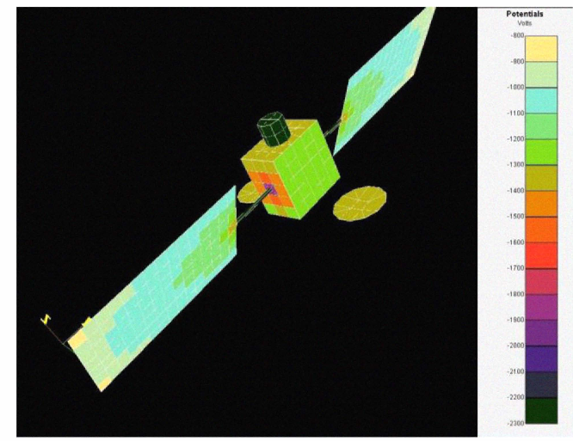
PLASMA EFFECTS
Discharging
Physical damage
Arc related EMI

Slide 13
PLASMA CONDITIONS
Medium is essentially macroscopically neutral
Particles exhibit collective behavior due to the long-range nature of the coulomb force
Number density is sufficiently high that the coulomb forCe is an important factor in determining its statistical properties
Electrostatic interactions dominate over the processes of ordinary gas kinetics

Slide 14
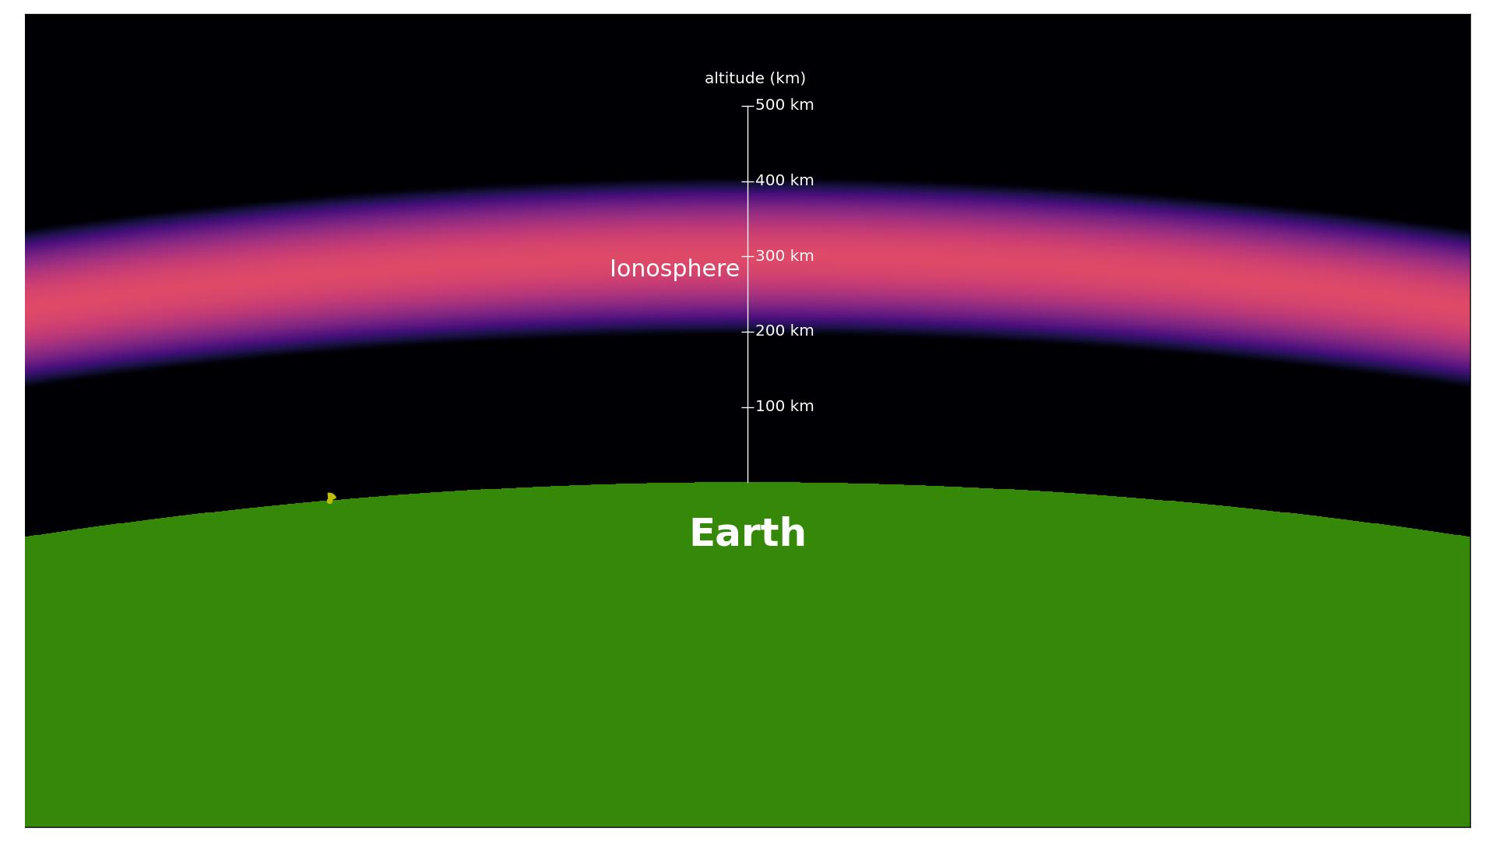
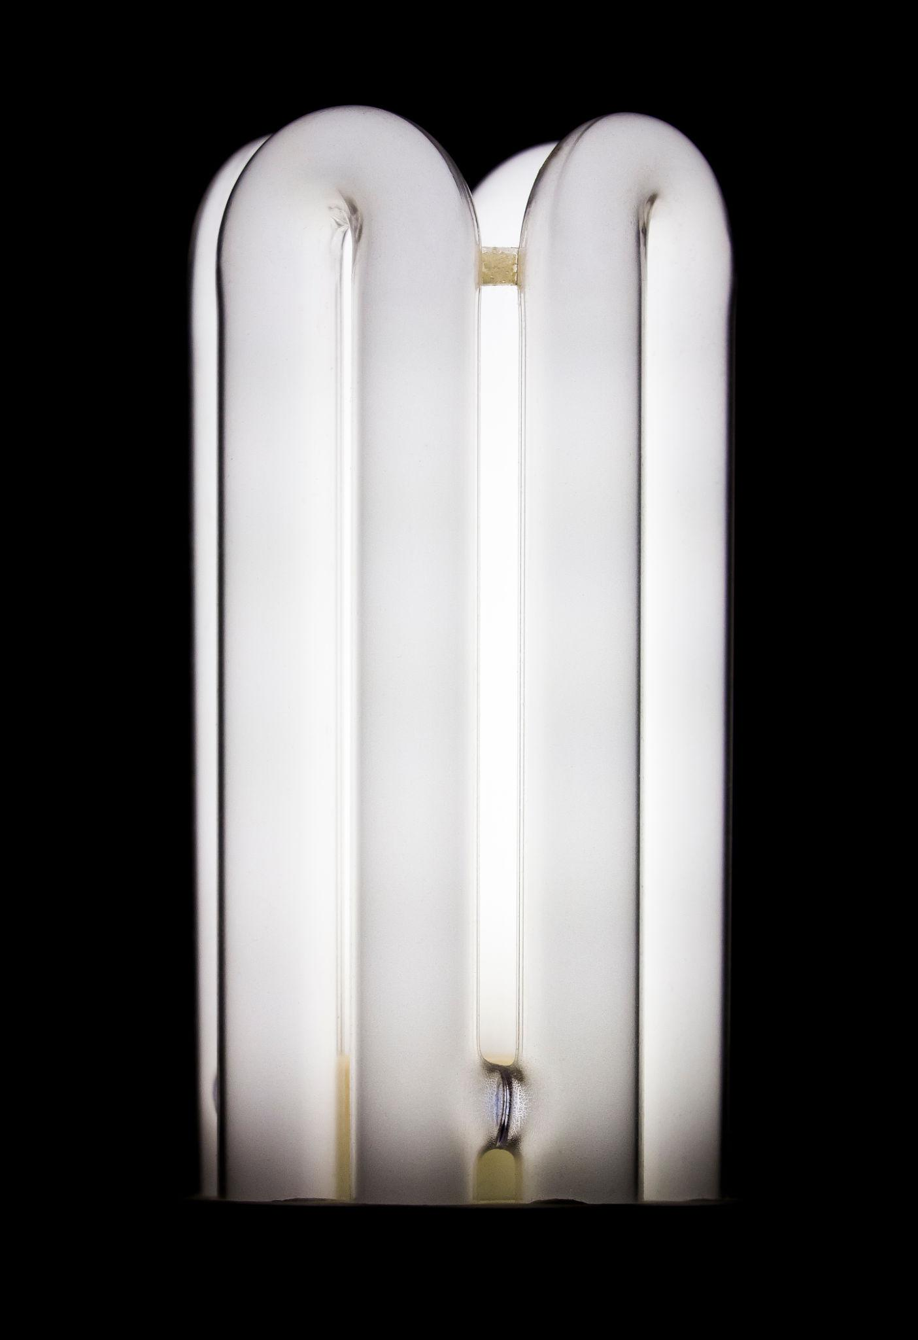
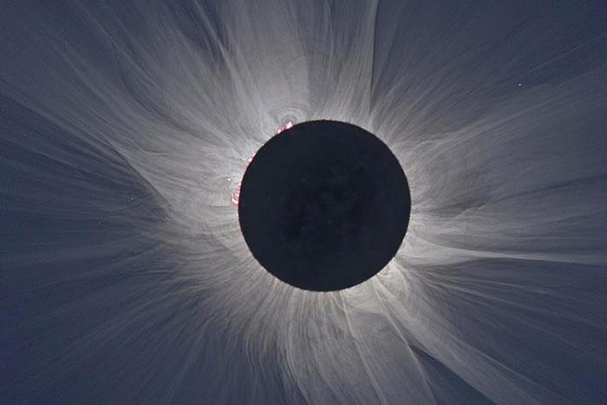
DEGREE OF IONIZATION

Slide 15
DEGREE OF IONIZATION

Slide 16
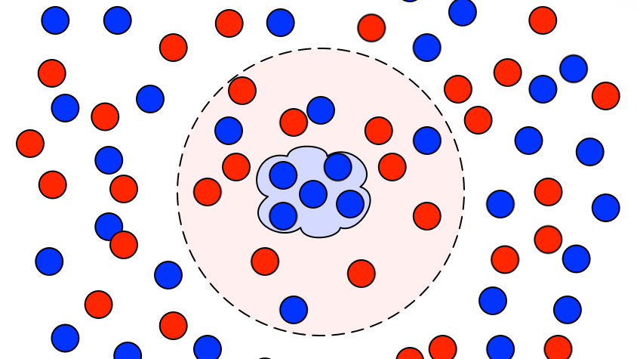
DEBYE LENGTH

Slide 17
DEBYE LENGTH

Slide 18
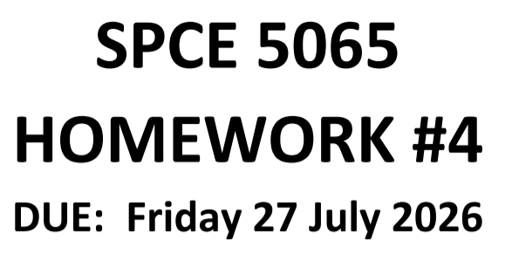
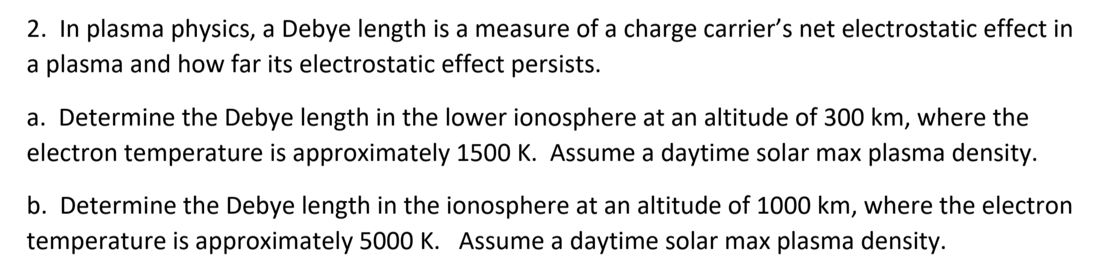

Slide 19
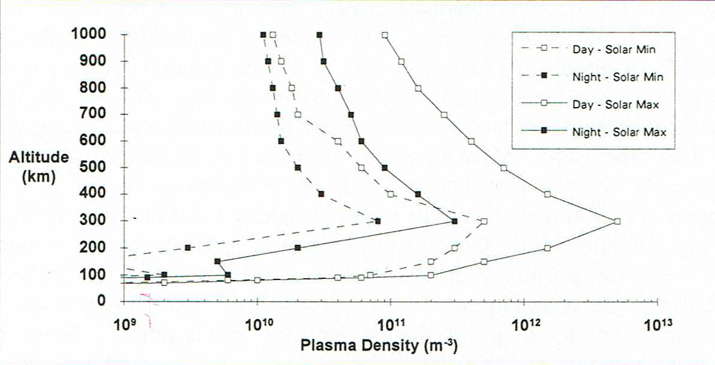
PLASMA DENSITY IN LEO

Slide 20
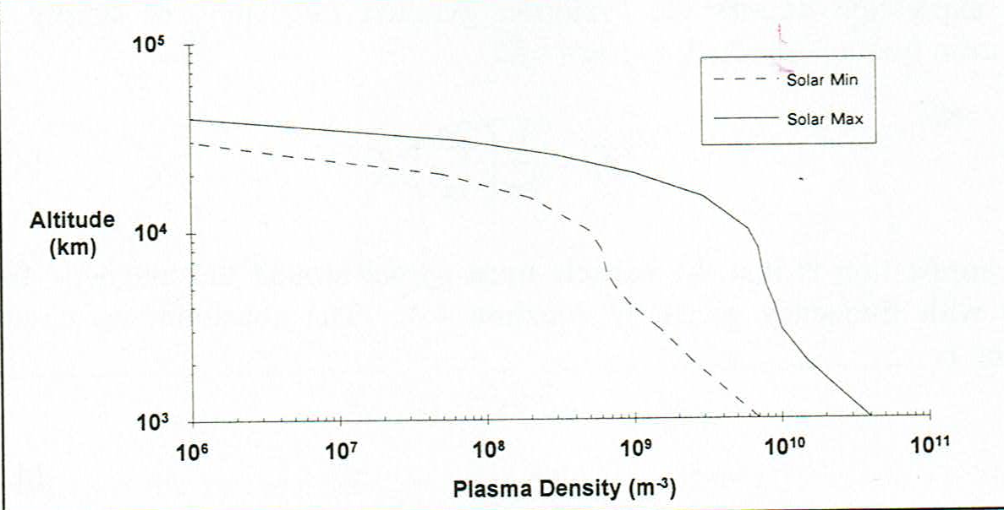
PLASMA DENSITY AT HIGHER ALTITUDES

Slide 21
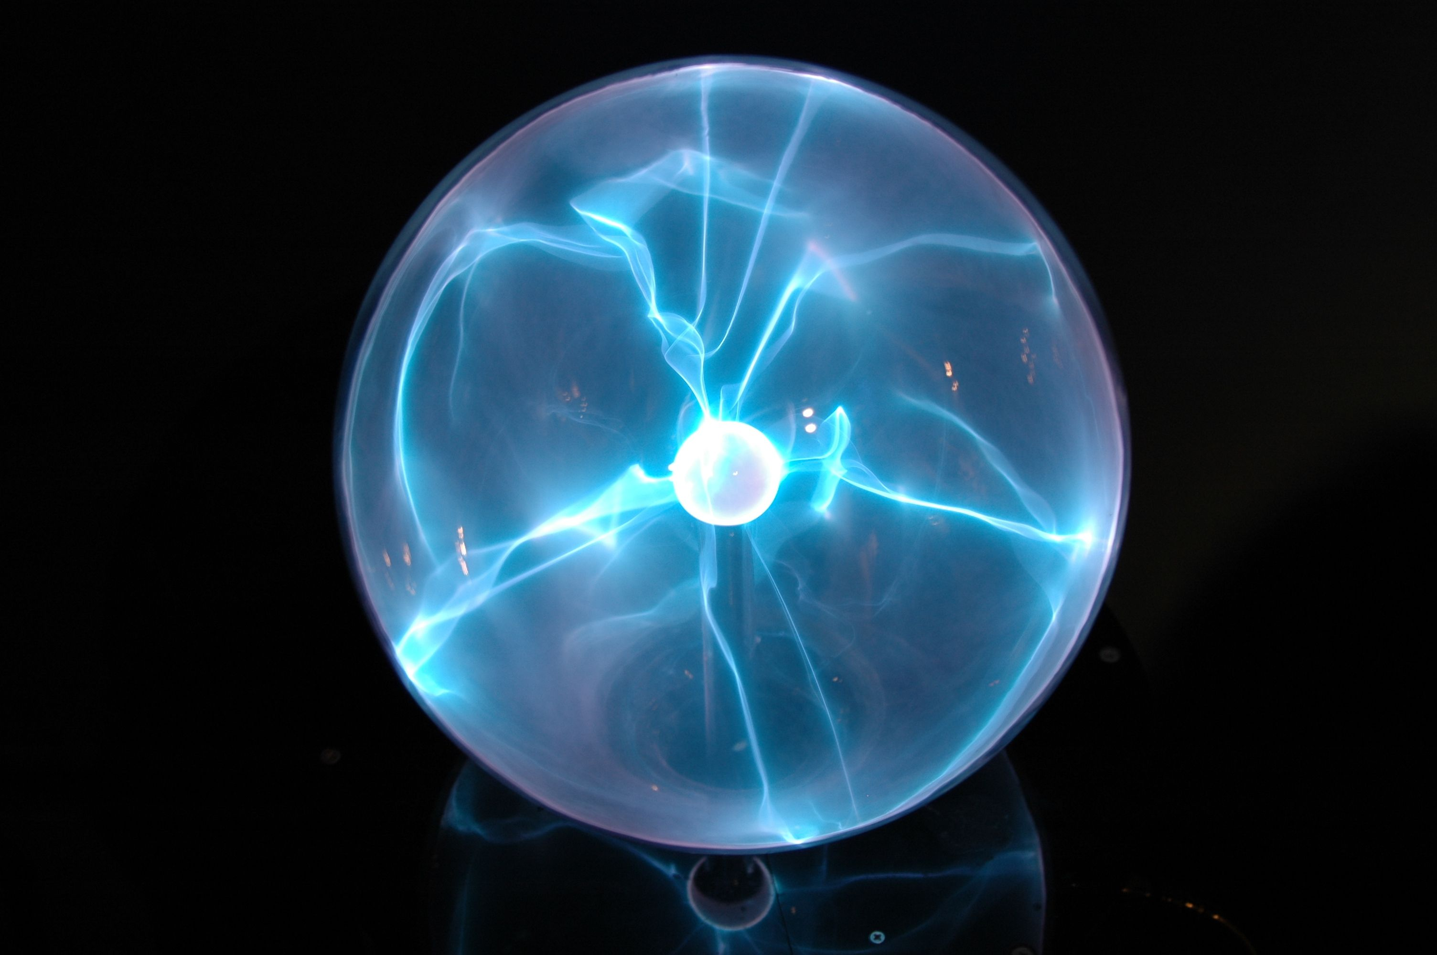

Plasma physics
Poisson’s equation
$∇.\overset{⃑}{D}= \overset{⃑}{ρ_{f}}$
Where
$\overset{⃑}{D}$= electric displacement field
$\overset{⃑}{ρ_{f}}$ = charge distribution

Slide 22
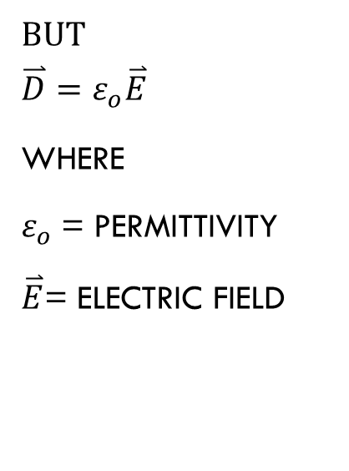
Plasma physics
But
$$\overset{⃑}{D}=ε_{o}\overset{⃑}{E}$$
Where
$ε_{o}$= permittivity
$\overset{⃑}{E}$= electric field

Slide 23
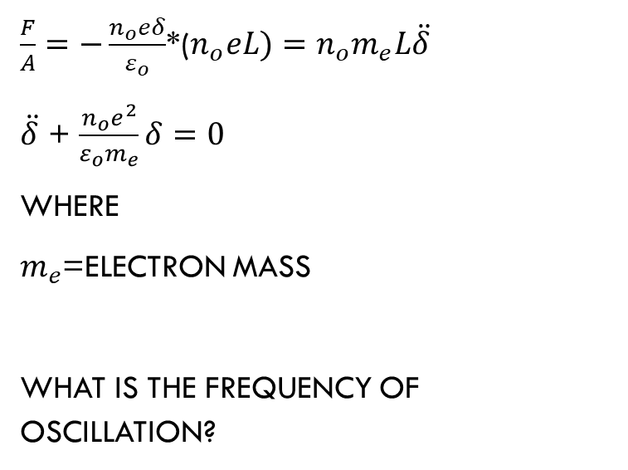
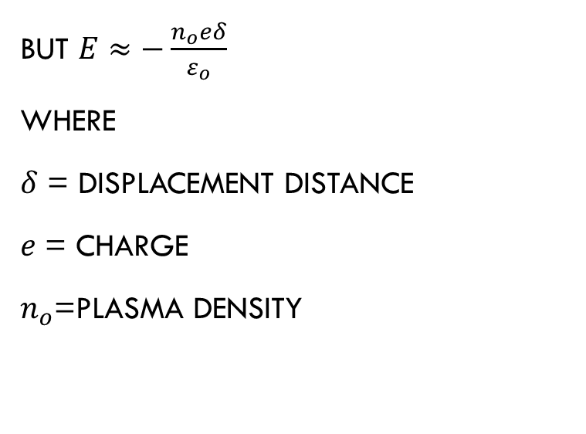
Plasma physics
But $E≈−\frac{n_{o}eδ}{ε_{o}}$
Where
$δ$ = displacement distance
$e$ = charge
$n_{o}$=plasma density
$\frac{F}{A}=−\frac{n_{o}eδ}{ε_{o}}$*($n_{o}eL)=n_{o}m_{e}L\ddot{δ}$
$\ddot{δ}$ + $\frac{n_{o}e^{2}}{ε_{o}m_{e}}δ=0$
Where
$m_{e}$=electron mass
What is the frequency of oscillation?

Slide 25
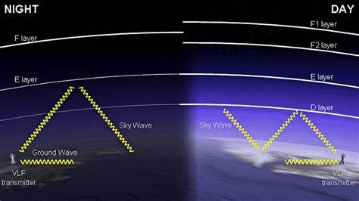

Plasma frequency of oscillation
$f= \frac{1}{2π}\sqrt{\frac{n_{0}e^{2}}{ε_{o}m_{e}}}$ Hz
This can be approximated by
$f≈8.979\sqrt{n_{o}}$ hz

Slide 26
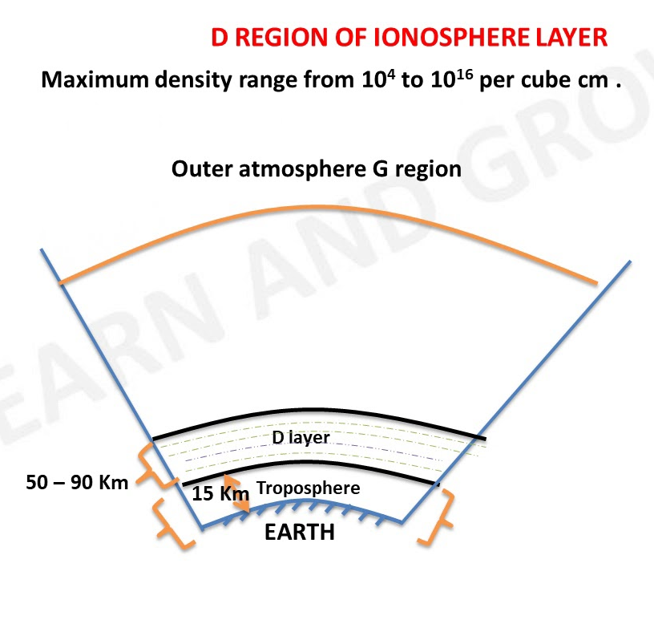
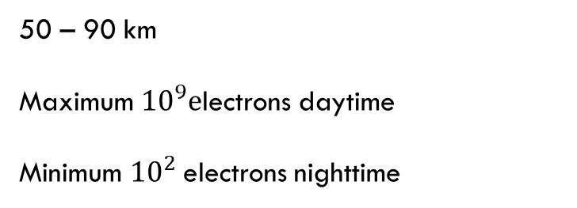
Ionosphere layers
50 – 90 km
Maximum ${10}^{9}e$lectrons daytime
Minimum ${10}^{2}$electrons nighttime
What are the maximum and minimum plasma frequencies?

Slide 27
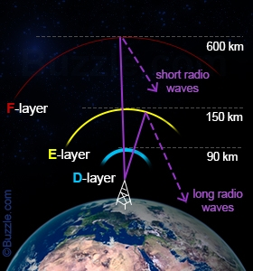
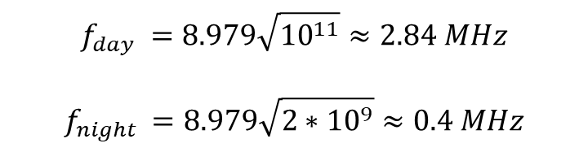
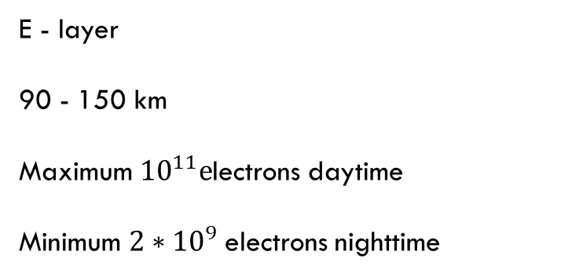
Ionosphere layers
E - layer
90 - 150 km
Maximum ${10}^{11}e$lectrons daytime
Minimum ${2∗10}^{9}$electrons nighttime
$$f_{day }=8.979\sqrt{{10}^{11}}≈2.84 MHz$$
$$f_{night }=8.979\sqrt{{2∗10}^{9}}≈0.4 MHz$$

Slide 28
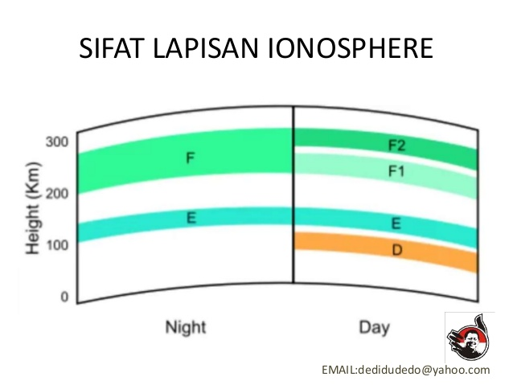
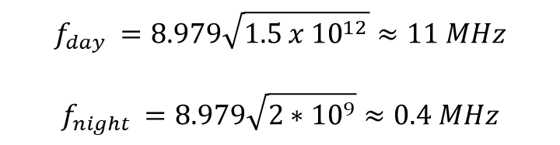
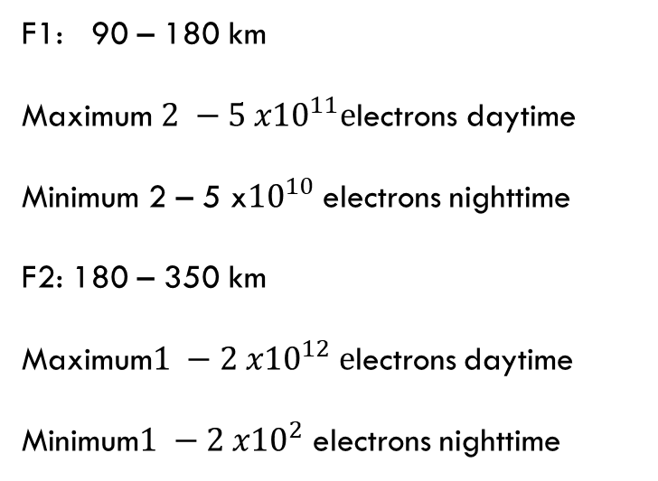
Ionosphere layers
F1: 90 – 180 km
Maximum ${2 −5 x10}^{11}e$lectrons daytime
Minimum 2 – 5 x${10}^{10}$electrons nighttime
F2: 180 – 350 km
Maximum${1 −2 x10}^{12} e$lectrons daytime
Minimum${1 −2 x10}^{2}$ electrons nighttime
$$f_{day }=8.979\sqrt{{1.5 x 10}^{12}}≈11 MHz$$
$$f_{night }=8.979\sqrt{{2∗10}^{9}}≈0.4 MHz$$

Slide 29
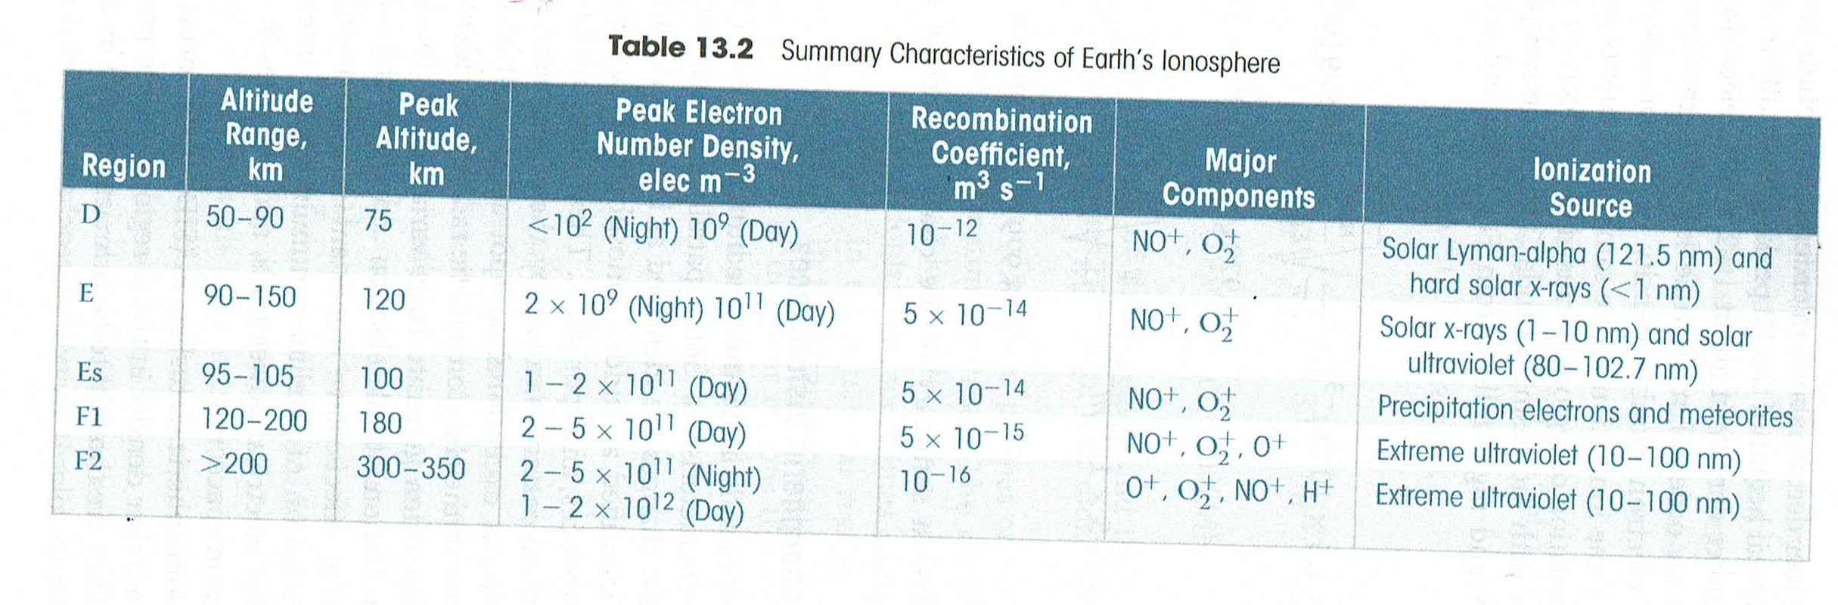
Summary of ionosphere

Slide 30
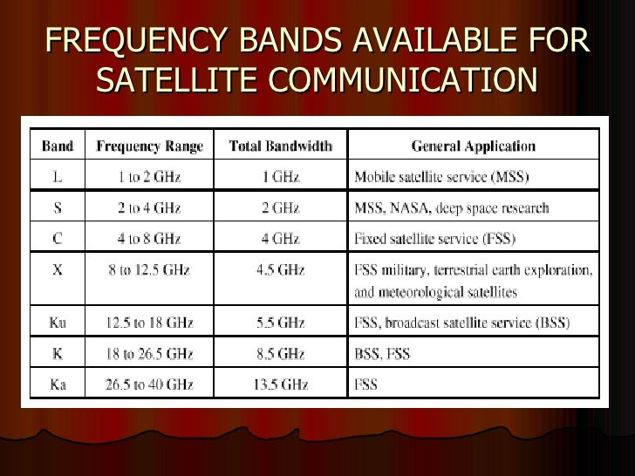
EXAMPLE
What is the approximate plasma frequency associated with a 250 km orbit?
What can you conclude about the use of typical satellite communication in the region?

Slide 31
EXAMPLE
What is the approximate plasma frequency associated with a 250 km orbit?
What can you conclude about the use of typical satellite communication in the region?

Slide 32
REFERENCES
Encyclopædia Britannica, inc. (n.d.). Physics and metaphysics of Aristotle. Encyclopædia Britannica. https://www.britannica.com/biography/Aristotle/Physics-and-metaphysics.
Sinha, A. (2020, December 3). Aristotelian Universe: the Earth-Centered Universe. Physics In My View. https://physicsinmyview.com/2020/08/model-of-aristotelian-universe.html.
Space solar cell edge, interconnect, and coverglass ... (n.d.).
https://www.researchgate.net/publication/224186897_Space_solar_cell_edge_interconnect_and_coverglass_designs_and_their_effect_on_spacecraft_charging_and_plasma_interactions.

